Slide 1
DevSecOps
Training

Slide 2
Agenda
https://docs.google.com/document/d/1Cydl3Eelcl1fEn4Epo7Ww7MBHmeIU3oC/edit

Slide 3
Training Format
Concepts
Hands-on exercises
Assignments
Interactive

Slide 4
Timing
Start time at 10 am
Break 11.30 am
Lunch 1pm to 2pm
Break 3.40
End at 6 pm

Slide 5
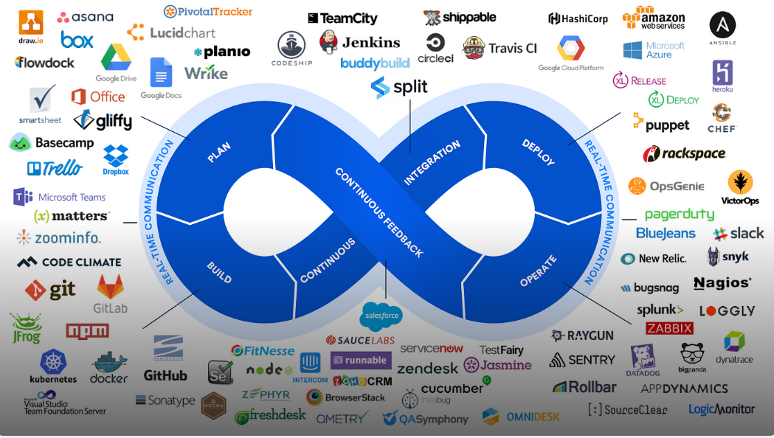
WHAT IS DEVOPS

Slide 6
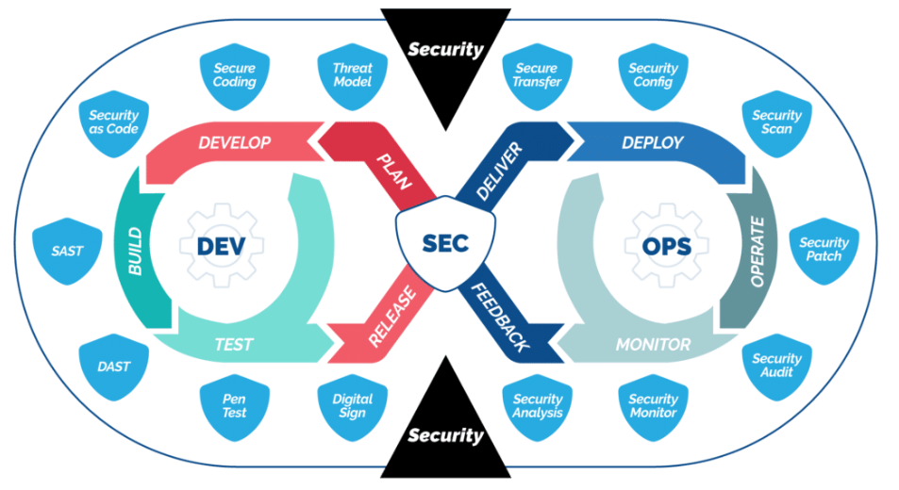
WHAT IS DEVSECOPS

Slide 7
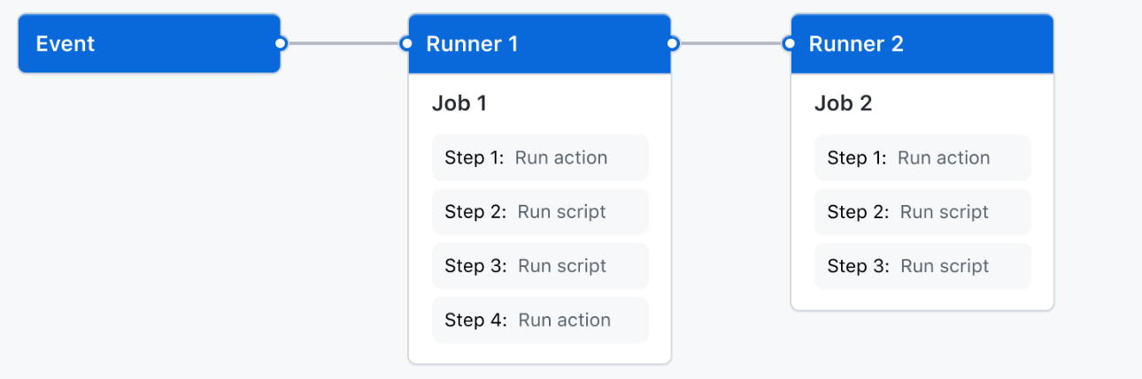
GitHub Actions: CI/CD & DevSecOps
Native CI/CD platform built into GitHub
Enables automation, security, and compliance
Pipelines as security enforcement points
Azure-centric, cloud-agnostic principles

Slide 8
Why GitHub Actions
CI/CD lives where the code lives
Event-driven, YAML-based pipelines
Strong ecosystem and security integrations
CI/CD as governance layer

Slide 9
GitHub Actions Architecture
Event-driven execution model
Workflows defined as code
Jobs run on isolated runners
Reproducible and auditable pipelines

Slide 10
Core Concepts
Workflow – pipeline definition
Event – trigger
Job – stage
Step – command or action
Runner – execution environment

Slide 11
Workflow Triggers
push – code changes
pull_request – security validation
workflow_dispatch – manual
schedule – periodic scans

Slide 12
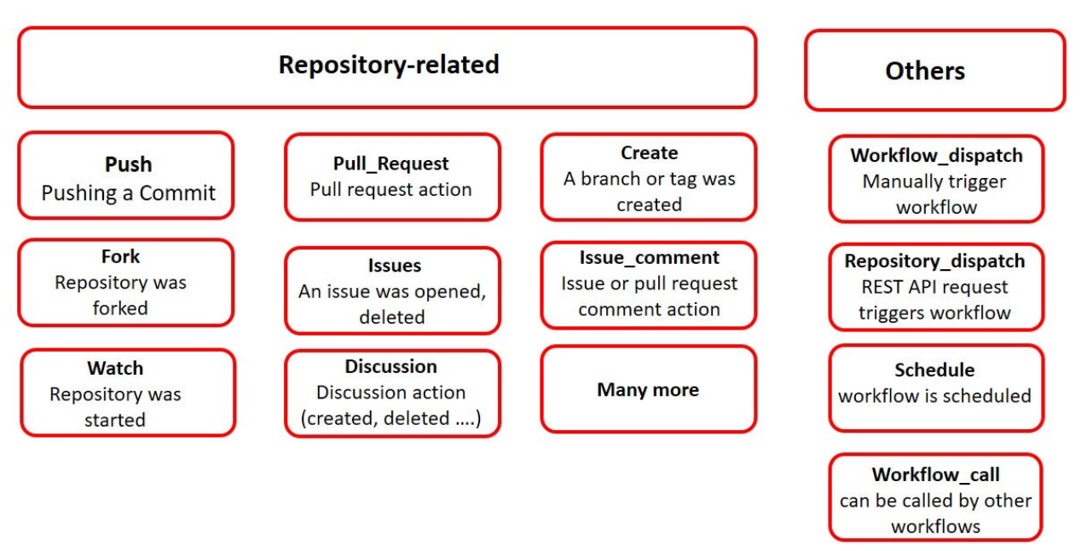
Workflow Triggers

Slide 13
Jobs & Parallelism
Parallel execution by default
needs enforces order
Fail fast on security issues

Slide 14
Runners
GitHub-hosted – ephemeral and secure
Self-hosted – private network access
Prefer ephemeral runners

Slide 15
Secrets Management
Encrypted secrets
Masked logs
Repo, environment, org scope
Separate per environment

Slide 16
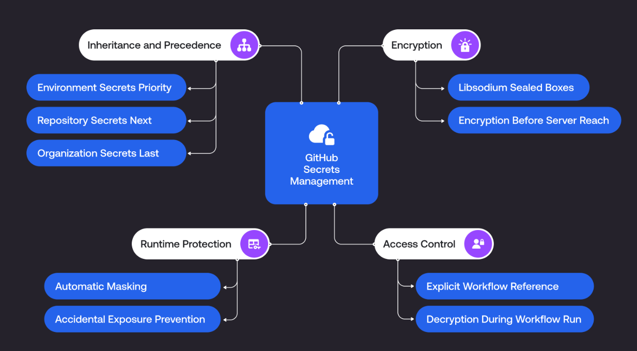
Secrets Management

Slide 17
Environments & Approvals
Dev / Test / Prod separation
Manual approvals
Audit trails

Slide 18
Reusable Workflows
Centralized pipeline logic
Standard security workflows
Platform-owned pipelines

Slide 19
Workflows
Creating an example workflow - GitHub Docs

Slide 20
Built-in GitHub Security
Secret scanning
Dependency graph
Dependabot
Code scanning

Slide 21
SAST
Static code analysis
Detects insecure patterns
Runs at PR stage

Slide 22
SCA
Dependency vulnerability scanning
License compliance
Automated update PRs

Slide 23
Policy as Code
Policies versioned as code
Automated enforcement
Audit-friendly

Slide 24
Security Gates
Block critical vulnerabilities
Policy-based gating
Prod approvals

Slide 25
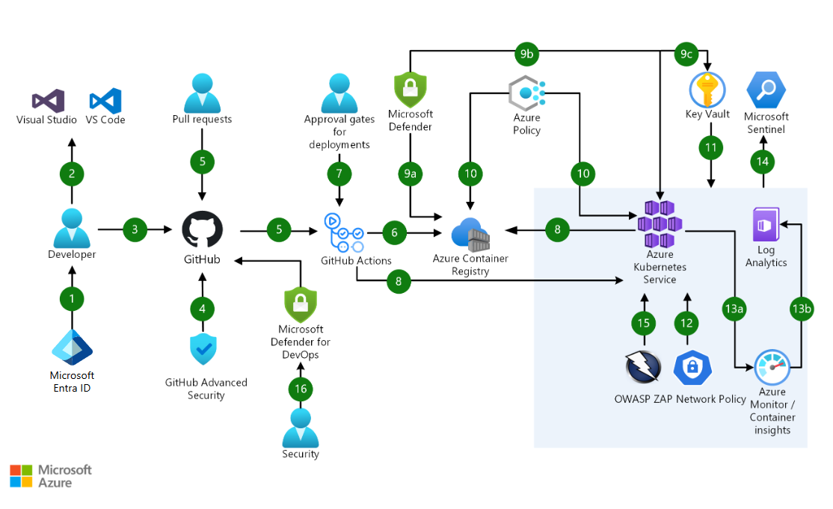
End-to-End Pipeline
Code → Build → Scan → Validate → Deploy

Slide 26
Common Mistakes
Security as optional
Long-lived secrets
Over-privileged runners

Slide 27
Key Takeaways
Pipelines are security controls
Shift-left is mandatory
Automation enables scale

Slide 28
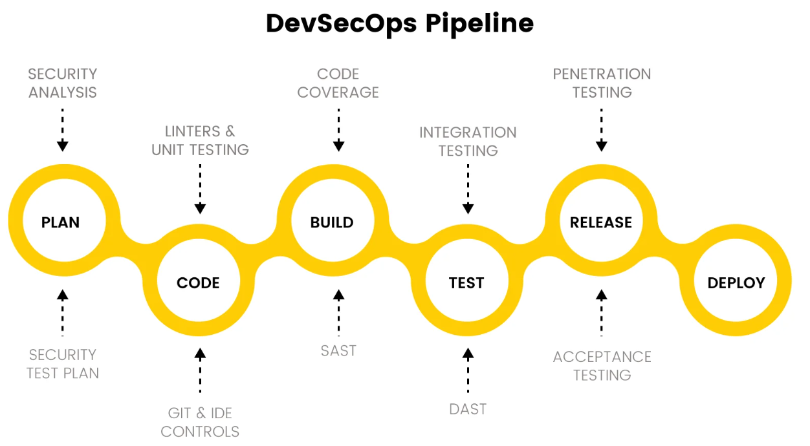
SAST & SCA with GitHub Actions

Slide 29
SAST & SCA with GitHub Actions
Application security fundamentals
Shift-left security in CI/CD
Automated code and dependency risk detection
Foundation of DevSecOps pipelines

Slide 30
Why Application Security Matters
Applications are the primary attack surface
Most breaches come from code or dependencies
Late fixes are costly and risky
CI/CD is the best enforcement point

Slide 31
What is SAST
Static analysis of source code
Detects insecure coding patterns
Finds logic and injection flaws
Runs without executing the application

Slide 32
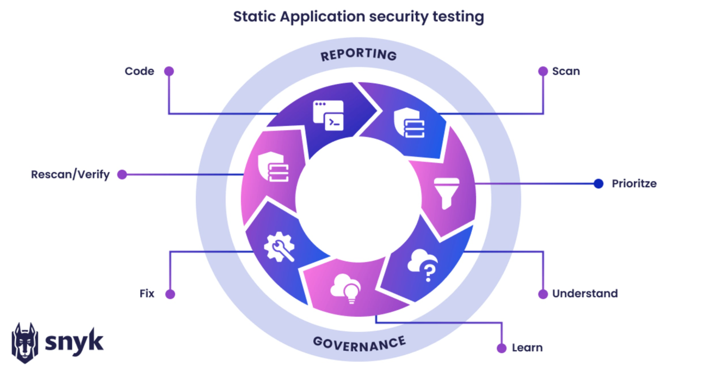
What is SAST

Slide 33
When and Where SAST is Used
Runs during commits and pull requests
Early feedback in SDLC
Does not require running app
Prevents insecure code from merging

Slide 34
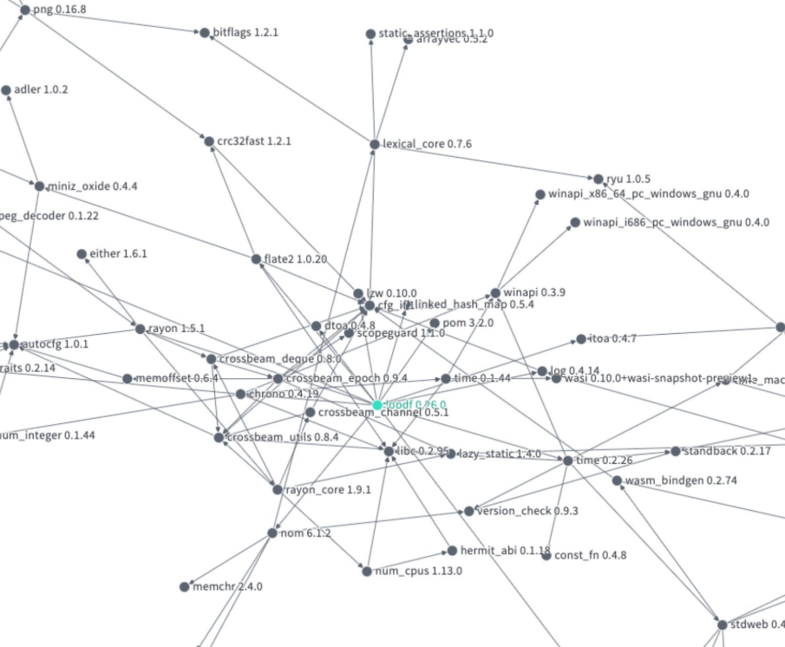
What is SCA
Scans third-party dependencies
Identifies known vulnerabilities (CVEs)
Detects license compliance risks
Tracks dependency versions

Slide 35
When and Where SCA is Used
Runs when dependencies change
Triggered on PRs and scheduled scans
Protects against supply chain attacks
Ensures visibility into open-source usage

Slide 36
SAST vs SCA
SAST focuses on custom code
SCA focuses on dependencies
SAST finds coding flaws
SCA finds known CVEs and licenses

Slide 37
Why Run SAST & SCA in CI/CD
Automation ensures consistency
Immediate developer feedback
Security integrated with PR reviews
Reduces manual security testing

Slide 38
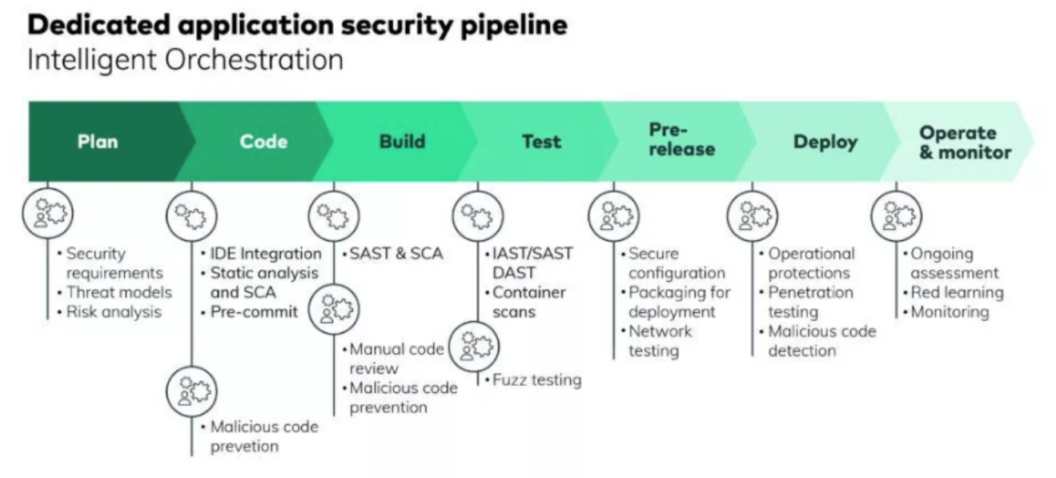
Why Run SAST & SCA in CI/CD

Slide 39
Why GitHub Actions
Native CI/CD inside GitHub
Automatic PR-based execution
Results visible to developers
Easy to standardize across teams

Slide 40
High-Level Security Flow
Code commit or PR
GitHub Actions triggers
SAST scans source code
SCA scans dependencies
Thresholds evaluated

Slide 41
SAST using GitHub Actions
Code checked out in CI
Static analyzer scans code
Issues mapped to files and lines
Results reported as PR checks

Slide 42
Common SAST Tools
CodeQL – GitHub native
Semgrep – rule-based scanning
SonarQube – deep analysis
Tool choice secondary to automation

Slide 43
SCA using GitHub Actions
Dependency files scanned
Versions matched with CVE databases
Severity classification
Results fail or warn pipelines

Slide 44
Common SCA Tools
Dependabot – GitHub native
OWASP Dependency-Check
Snyk – commercial option
Start with native tools

Slide 45
Pull Request Security Flow
PR opened by developer
SAST and SCA run automatically
Findings shown in PR
Merge blocked on critical issues

Slide 46
Severity & Gating
Critical, High, Medium, Low findings
Pipelines fail based on thresholds
Risk-based enforcement
Start strict gradually

Slide 47
Managing False Positives
Initial noise is expected
Requires baselining and tuning
Suppressions must be reviewed
Never ignore blindly

Slide 48
Scaling with Reusable Workflows
Centralized security workflows
Consistent rules across repos
Platform team owns security logic
App teams consume easily

Slide 49
Role in DevSecOps
GitHub Actions as execution engine
SAST and SCA as app security layer
IaC scanning next layer
Policy gates provide governance

Slide 50
Key Takeaways
SAST secures custom code
SCA secures dependencies
CI/CD enables shift-left security
Automation beats manual reviews

Slide 51
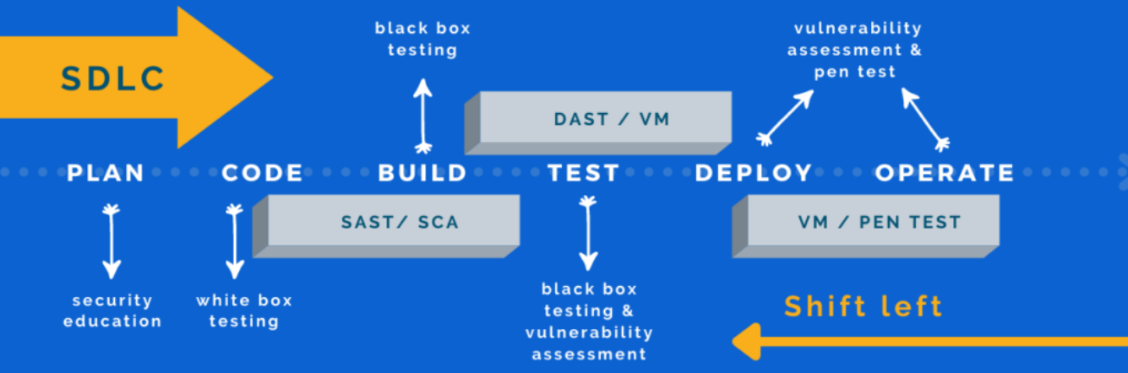
Key Takeaways

Slide 52
IaC & IaC Security Scanning
Infrastructure as Code fundamentals
Terraform as industry standard
Shift-left infrastructure security
Prevent cloud misconfigurations early

Slide 53
What is Infrastructure as Code
Infrastructure defined using code
Version-controlled and repeatable
Automated provisioning
Eliminates manual configuration

Slide 54
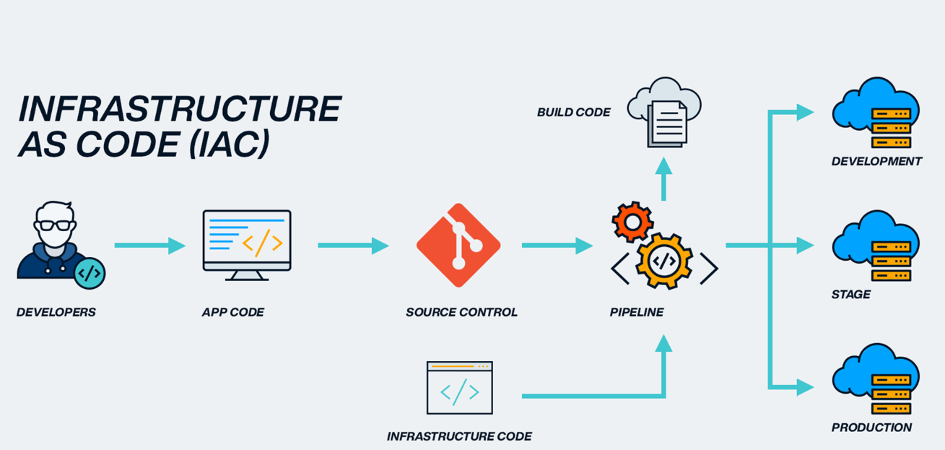
What is Infrastructure as Code

Slide 55
Why IaC Matters
Consistency across environments
Faster provisioning
Reduced human error
Full audit trail via Git

Slide 56
Pre requisites
Install terraform

Slide 57
Terraform Overview
Declarative infrastructure language (HCL)
Multi-cloud support
Manages full resource lifecycle
State-driven infrastructure

Slide 58
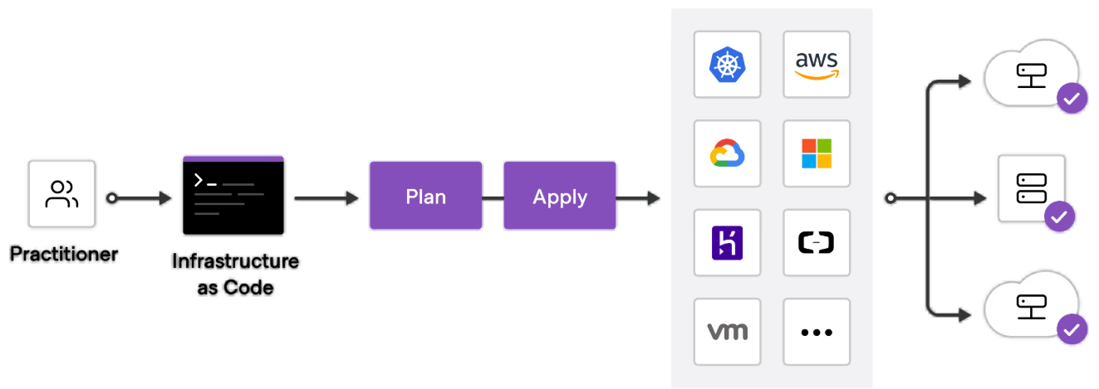
Terraform Overview

Slide 59
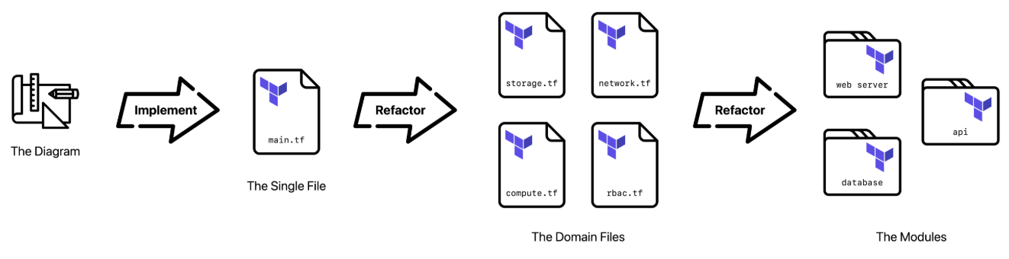
Terraform Core Concepts
Providers connect to cloud platforms
Resources define infrastructure
Modules enable reuse
State tracks real infrastructure
Plan previews changes

Slide 60
Terraform Core Concepts

Slide 61
Risks with IaC
IaC can create insecure infrastructure
Misconfigurations at scale
Public exposure risks
Over-permissive access

Slide 62
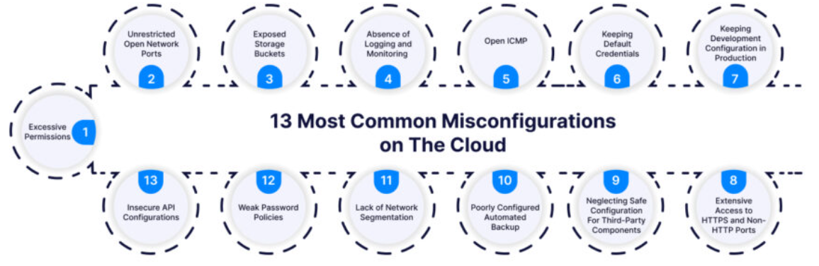
Risks with IaC

Slide 63
What is IaC Scanning
Static analysis of IaC code
Detects misconfigurations early
No deployment required
IaC scanning is SAST for infrastructure

Slide 64
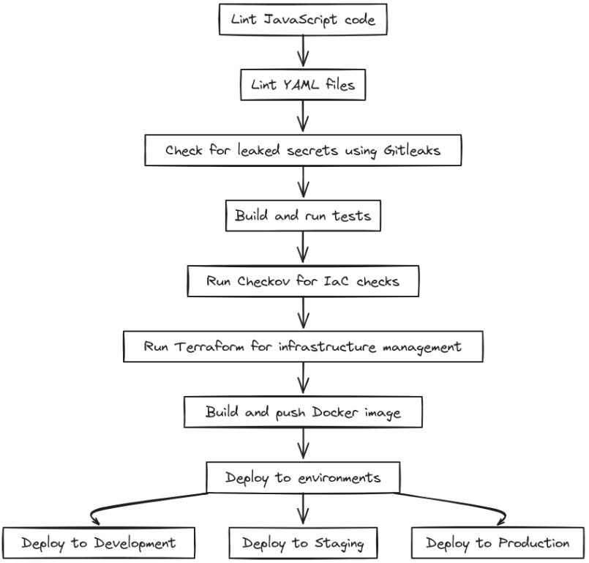
What IaC Scanning Detects
Publicly exposed resources
Open network ports
Missing encryption
Insecure IAM permissions

Slide 65
IaC Scanning in CI/CD
Runs on pull requests
Prevents insecure deployments
Cheaper than post-deploy fixes
CI/CD as guardrail

Slide 66
IaC Scanning with GitHub Actions
IaC code stored in GitHub
Actions trigger scans on PR
Results visible to developers
Easy to standardize scanning

Slide 67
High-Level IaC Scanning Flow
Terraform change committed
Pull request opened
GitHub Actions runs scan
Issues detected
PR blocked or approved

Slide 68
Common IaC Scanning Tools
Checkov – policy-based scanning
tfsec – Terraform focused
Terrascan – multi-IaC support
OPA/Conftest – policy enforcement

Slide 69
IaC Scanning vs Runtime Security
IaC scanning prevents issues
Runtime security detects issues
Prevention preferred
Both are required

Slide 70
Severity & Gating
Findings classified by severity
Critical and High can block PRs
Risk-based enforcement
Gradual adoption recommended

Slide 71
Developer Experience
Fast feedback
Clear error messages
Line-level findings
Security should guide developers

Slide 72
Scaling IaC Security
Reusable scanning workflows
Centralized policy ownership
Consistent enforcement
Enterprise-ready approach

Slide 73
IaC Scanning in DevSecOps
Complements SAST and SCA
Covers infrastructure risks
Part of layered security
Enforced via CI/CD

Slide 74
Common Anti-Patterns
Scanning after deployment
Ignoring IaC findings
Manual cloud changes
No enforcement gates

Slide 75
Typical Enterprise Flow
Code change
PR scan
Security approval
Deployment
Continuous compliance

Slide 76
Exercise
Checkov
arjunachari12/iac-devsecops-training

Slide 77
Key Takeaways
IaC is powerful but risky
Terraform is standard
IaC scanning prevents misconfigurations
Shift-left security is essential

Slide 78
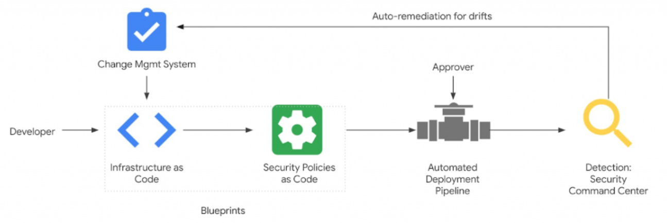
Policy as Code using Terraform
Governance expressed as code
Automated enforcement of organizational rules
Foundation for compliant DevSecOps
Prevents non-compliant deployments

Slide 79
Why Policy as Code
Manual governance does not scale
Inconsistent enforcement across teams
Late compliance failures are costly
Policies must be automated

Slide 80
What is Policy as Code
Policies written in machine-readable form
Version-controlled like application code
Automatically enforced by tools
Auditable and repeatable

Slide 81
Policy as Code vs Scanning
Scanning finds misconfigurations
Policies define what is allowed
Scanning is detection
Policy is enforcement

Slide 82
Why Terraform for Policy
Terraform is widely adopted
Manages infrastructure lifecycle
Supports policy enforcement
Integrates well with CI/CD

Slide 83
Terraform Governance Layers
Terraform configuration standards
Module-level guardrails
Policy engines
Pipeline enforcement

Slide 84
Common Policy Use Cases
Approved regions only
Mandatory encryption
Restricted instance types
Naming and tagging standards

Slide 85
Policy as Code Tools
OPA / Conftest
Terraform Sentinel
Checkov policies
Cloud-native policy engines

Slide 86
Policy Enforcement in CI/CD
Policies evaluated during PRs
Violations fail pipelines
Manual overrides are tracked
CI/CD becomes governance layer

Slide 87
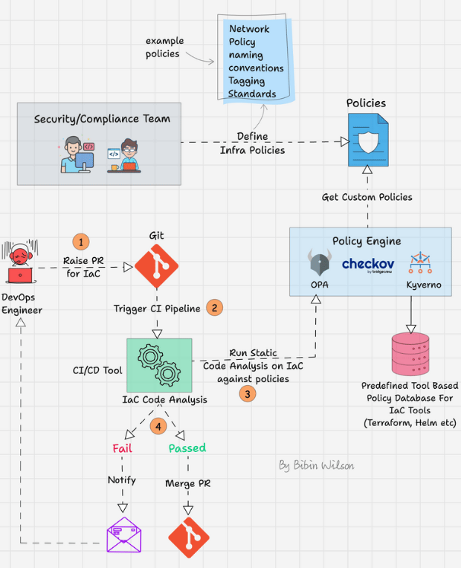
Policy Enforcement in CI/CD

Slide 88
Exercise
OPA and Conftest
arjunachari12/iac-devsecops-training

Slide 89
Policy Evaluation Flow
Terraform code change
PR opened
Policy checks executed
Pass or block decision

Slide 90
Policy Violations
Clear error messages
Explain why blocked
Guide remediation
Consistent enforcement

Slide 91
Developer Experience
Fast policy checks
Actionable feedback
Minimal false positives
Security as guidance

Slide 92
Scaling Policy as Code
Central policy repositories
Reusable policies
Platform team ownership
Consistent org-wide governance

Slide 93
Policy as Code in DevSecOps
Complements SAST and SCA
Complements IaC scanning
Enables preventive governance
Enforced via pipelines

Slide 94
Common Anti-Patterns
Manual policy reviews
Hardcoded rules
No exception process
Bypassing pipelines

Slide 95
Enterprise Governance Flow
Code change
Security checks
Policy validation
Approval gates
Deployment

Slide 96
Benefits to Organization
Reduced compliance risk
Faster audits
Consistent security posture
Developer autonomy with guardrails

Slide 97
Key Takeaways
Policies must be automated
Terraform enables governance
CI/CD is enforcement point
Policy as Code scales compliance

Slide 98
Azure DevOps: CI/CD Overview for Enterprise DevOps
End-to-end DevOps platform by Microsoft
Widely used in regulated and large organizations
Strong governance, RBAC, and approvals
Azure-first but cloud-agnostic

Slide 99
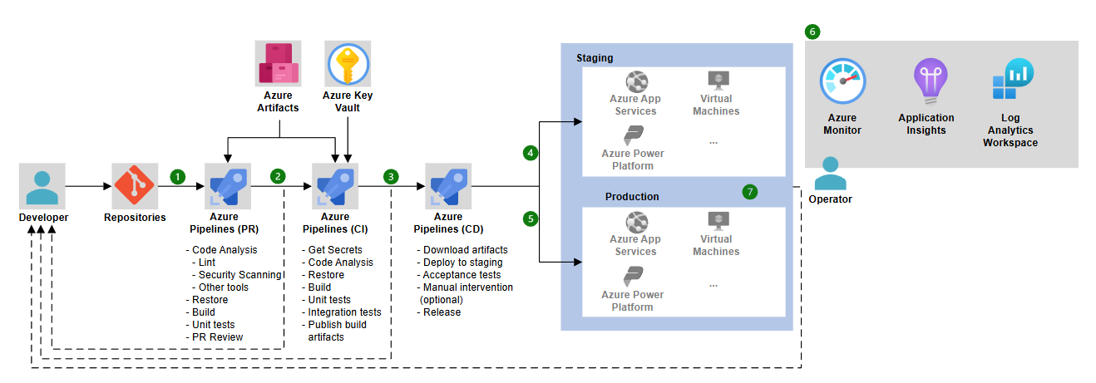
Azure DevOps in DevSecOps

Slide 100
Why Azure DevOps
Enterprise-ready and mature platform
Strong separation of duties
Built-in governance and approvals
Ideal for compliance-heavy environments

Slide 101
Azure DevOps Core Services
Azure Boards – Work tracking
Azure Repos – Git repositories
Azure Pipelines – CI/CD
Azure Artifacts – Package feeds
Azure Test Plans – Manual testing

Slide 102
Azure Pipelines Overview
Supports CI and CD pipelines
YAML-based pipelines (recommended)
Classic pipelines (legacy)
Cloud-agnostic execution

Slide 103
CI vs CD in Azure DevOps
CI – Build and validate code
Triggered on commit or PR
CD – Deploy artifacts
Environment-specific approvals

Slide 104
Pipeline Agents
Microsoft-hosted agents – managed and ephemeral
Secure by default
Self-hosted agents – private network access
Higher operational responsibility

Slide 105
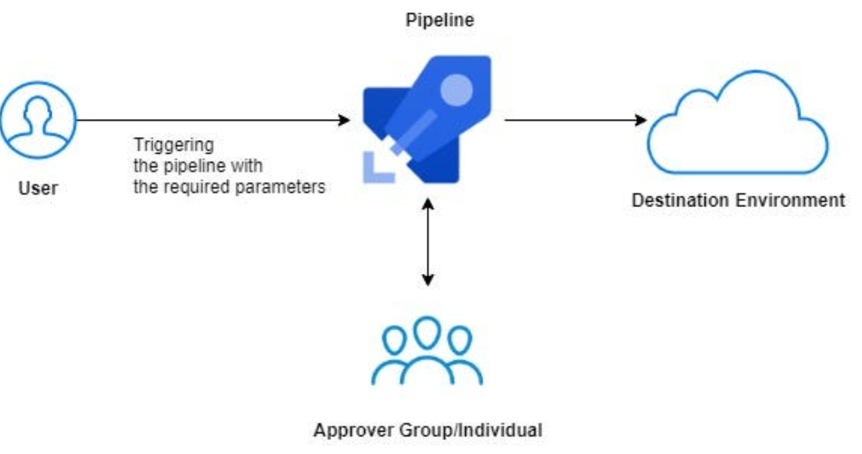
Environments & Approvals
Logical environments: Dev, Test, Prod
Manual approvals
Environment-level checks
Full deployment history

Slide 106
Variables & Secrets
Pipeline variables
Variable groups
Azure Key Vault integration
Secrets never stored in code

Slide 107
Azure DevOps in DevSecOps
CI as security entry point
CD as policy enforcement layer
Strong audit trails
Ideal for regulated workloads

Slide 108
Azure DevOps vs GitHub Actions
Azure DevOps – governance-first
Strong CD and approvals
GitHub Actions – developer-first
Many organizations use both

